Slide 1


Density Planner for Robotic Systems
Sriram Krishnamoorthy sriramk@clemson.edu

Slide 2





Planar 2 link Arm Dynamics
$M\left(q\right)\ddot{q}+C\left(q,\dot{q}\right)\dot{q}+G\left(q\right)=bu$
q₁
$$τ_{1}$$
$$M\left(q\right)= \left[\begin{matrix}\begin{aligned}m_{1}l_{1}^{2}+m_{2}l_{2}^{2}+m_{2}l_{1}^{2}+2m_{2}l_{c2}\cos\left(q_{2}\right) \\ m_{2}l_{2}^{2}+m_{2}l_{1}l_{c2}\cos\left(q_{2}\right)\end{aligned} & \begin{aligned}m_{2}l_{2}^{2}+m_{2}l_{1}l_{c2}\cos\left(q_{2}\right) \\ I_{2}\end{aligned}\end{matrix}\right]$$
l_{c1}
m₁
l₁
$$C\left(q,\dot{q}\right)=\left[\begin{matrix}\begin{aligned}−2m_{2}l_{1}l_{c2}\sin\left(q_{2}\right){\dot{q}}_{2} \\ m_{2}l_{1}l_{c2}\sin\left(q_{2}\right){\dot{q}}_{1}\end{aligned} & \begin{aligned}{−m}_{2}l_{1}l_{c2}\sin\left(q_{2}\right){\dot{q}}_{2} \\ 0\end{aligned}\end{matrix}\right]$$
$$τ_{2}$$
m₂, l_{c2}, l₂
$G\left(q\right)=−\left[\begin{aligned}\left(m_{1}l_{c1}+m_{2}l_{1}\right)gsin\left(q_{1}\right)+m_{2}gl_{2}sin⁡(q_{1}+q_{2}) \\ m_{2}gl_{2}\sin\left(q_{1}+q_{2}\right)\end{aligned}\right]$
q₂
$$b=\left[\begin{aligned}1 \\ 1\end{aligned}\right]$$
DIRA Research Lab

Slide 3

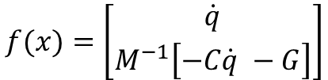





Planar 2 link Arm – State Space
$$q=\left[\begin{matrix}q_{1} \\ \begin{aligned}q_{2}\end{aligned}\end{matrix}\right]$$
$$\dot{q}=\left[\begin{matrix}\begin{aligned}\begin{aligned}{\dot{q}}_{1} \\ {\dot{q}}_{2}\end{aligned}\end{aligned}\end{matrix}\right]$$
$$x=\left[\begin{matrix}q \\ \begin{aligned}\begin{aligned}\dot{q}\end{aligned}\end{aligned}\end{matrix}\right]$$
q₁
$$\dot{x}=f\left(x\right)+g\left(x\right)u$$
l_{c1}
m₁
l₁
$$f(x)=\left[\begin{matrix}\dot{q} \\ M^{−1}\left[−C\dot{q} −G\right]\end{matrix}\right]$$
$$g\left(x\right)= \left[\begin{matrix}0 \\ M^{−1}b\end{matrix}\right]$$
$$τ$$
m₂, l_{c2}, l₂
q₂
DIRA Research Lab

Slide 4






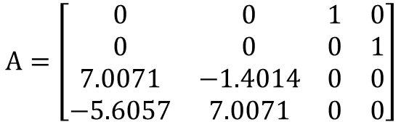
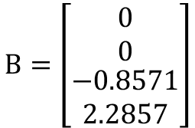
Planar 2 link Arm – Linearization
Linearize about the upright position ($q_{1},q_{2}=0$)
q₁
$$q=\left[\begin{matrix}q_{1} \\ \begin{aligned}q_{2}\end{aligned}\end{matrix}\right]$$
$$\dot{q}=\left[\begin{matrix}\begin{aligned}\begin{aligned}{\dot{q}}_{1} \\ {\dot{q}}_{2}\end{aligned}\end{aligned}\end{matrix}\right]$$
$$x=\left[\begin{matrix}q \\ \begin{aligned}\begin{aligned}\dot{q}\end{aligned}\end{aligned}\end{matrix}\right]$$
$$\dot{x}=Ax+Bu$$
l_{c1}
m₁
l₁
$$A=\left[\begin{matrix}0 & 0 & 1 & 0 \\ 0 & 0 & 0 & 1 \\ 7.0071 & −1.4014 & 0 & 0 \\ −5.6057 & 7.0071 & 0 & 0\end{matrix}\right]$$
$$B=\left[\begin{matrix}0 \\ 0 \\ \begin{aligned}−0.8571 \\ 2.2857\end{aligned}\end{matrix}\right]$$
$$τ$$
m₂, l_{c2}, l₂
$$eig\left(A\right)=0±0.115i, ∓0.0364$$
q₂
DIRA Research Lab

Slide 5
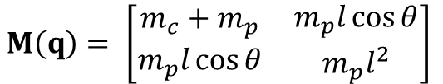





Cart Pole Dynamics
$M\left(q\right)\ddot{q}+C\left(q,\dot{q}\right)\dot{q}+G\left(q\right)=Bu$
$$M\left(q\right)= \left[\begin{matrix}\begin{aligned}m_{c}+m_{p} \\ m_{p}l\cos{θ}\end{aligned} & \begin{aligned}m_{p}l\cos{θ} \\ m_{p}l^{2}\end{aligned}\end{matrix}\right]$$
m_{p} = 2
$$θ$$
$$C\left(q,\dot{q}\right)=\left[\begin{matrix}\begin{aligned}0 \\ 0\end{aligned} & \begin{aligned}m_{p}l\dot{θ}\sin{θ} \\ 0\end{aligned}\end{matrix}\right]$$
L = 0.5
_{x}
_{f}
m_{c} = 8
$G\left(q\right)=\left[\begin{aligned}0 \\ {−m}_{p}gl\sin{θ}\end{aligned}\right]$
$$B=\left[\begin{aligned}1 \\ 0\end{aligned}\right]$$
DIRA Research Lab

Slide 6

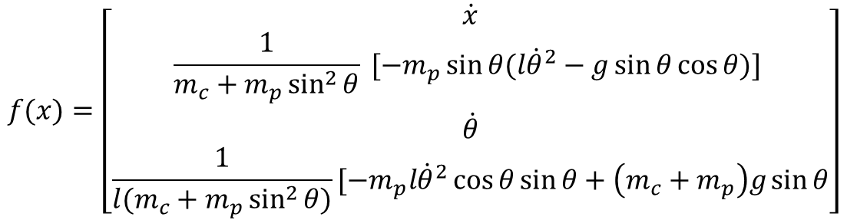
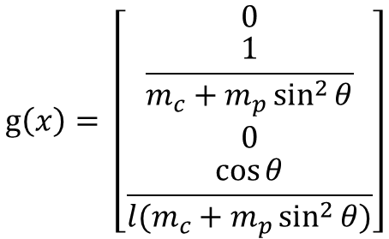
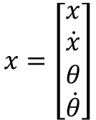
Cart Pole Dynamics – State Space
$$x=\left[\begin{matrix}x \\ \dot{x} \\ \begin{aligned}θ\end{aligned} \\ \dot{θ}\end{matrix}\right]$$
$$\dot{x}=f\left(x\right)+g\left(x\right)u$$
m_{p}
$$f(x)=\left[\begin{matrix}\dot{x} \\ \frac{1}{m_{c}+m_{p}\sin^{2}{θ}} [{−m}_{p}\sin{θ(l{\dot{θ}}^{2}−g\sin{θ}cos{θ)] }} \\ \begin{aligned}\dot{θ} \\ \frac{1}{{l(m}_{c}+m_{p}\sin^{2}{θ)}}[−m_{p}l{\dot{θ}}^{2}\cos{θ\sin{θ+\left(m_{c}+m_{p}\right)g\sin{θ}}}\end{aligned}\end{matrix}\right]$$
$$θ$$
l
_{x}
_{f}
m_{c}
$$g\left(x\right)= \left[\begin{matrix}0 \\ \frac{1}{m_{c}+m_{p}\sin^{2}{θ}} \\ 0 \\ \frac{\cos{θ}}{{l(m}_{c}+m_{p}\sin^{2}{θ})}\end{matrix}\right]$$
DIRA Research Lab
https://danielpiedrahita.wordpress.com/portfolio/cart-pole-control/

Slide 7


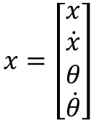

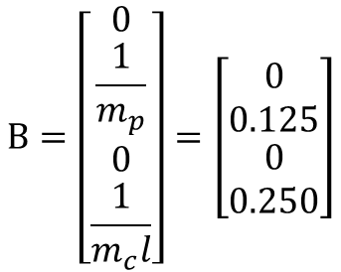
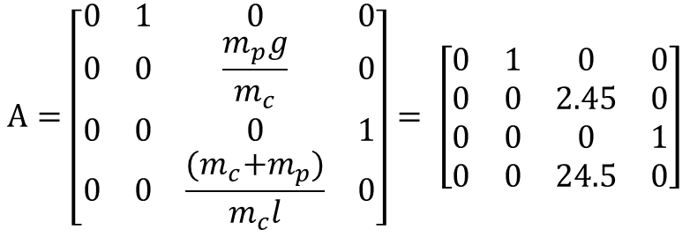

Cart Pole Dynamics – Linearization
Linearize about the upright position ($θ_{0}=0$)
$$x_{0}=[0 0 θ_{0} 0]$$
$$x=\left[\begin{matrix}x \\ \dot{x} \\ \begin{aligned}θ\end{aligned} \\ \dot{θ}\end{matrix}\right]$$
$$\dot{x}=Ax+Bu$$
m_{p}
$$θ$$
$$A=\left[\begin{matrix}0 & 1 & 0 & 0 \\ 0 & 0 & \frac{m_{p}g}{m_{c}} & 0 \\ 0 & 0 & 0 & 1 \\ 0 & 0 & \frac{{(m}_{c}+m_{p})}{m_{c}l} & 0\end{matrix}\right]= \left[\begin{matrix}0 & 1 & 0 & 0 \\ 0 & 0 & 2.45 & 0 \\ 0 & 0 & 0 & 1 \\ 0 & 0 & 24.5 & 0\end{matrix}\right]$$
l
_{x}
_{f}
m_{c}
$$m_{c}=8;m_{p}=2;l=0.5$$
$$B=\left[\begin{matrix}0 \\ \frac{1}{m_{p}} \\ \begin{aligned}0 \\ \frac{1}{m_{c}l}\end{aligned}\end{matrix}\right]=\left[\begin{matrix}0 \\ 0.125 \\ \begin{aligned}0 \\ 0.250\end{aligned}\end{matrix}\right]$$
DIRA Research Lab
https://danielpiedrahita.wordpress.com/portfolio/cart-pole-control/

Slide 8

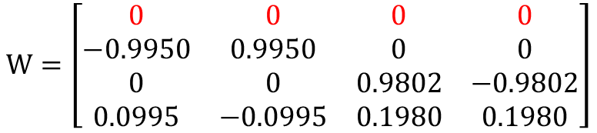
Cart Pole Dynamics – Procedure 1
Problem: Left eigenvector of A is singular, (zero eigenvalues )
$$eig\left(A\right)=0, 0, ± 4.9497$$
m_{p}
$$θ$$
$$W=\left[\begin{matrix}0 & 0 & 0 & 0 \\ −0.9950 & 0.9950 & 0 & 0 \\ 0 & 0 & 0.9802 & −0.9802 \\ 0.0995 & −0.0995 & 0.1980 & 0.1980\end{matrix}\right]$$
l
_{x}
_{f}
m_{c}
$$m_{c}=8;m_{p}=2;l=0.5$$
https://danielpiedrahita.wordpress.com/portfolio/cart-pole-control/

Slide 9




Planar 2 link Arm Dynamics
$$goal$$
$$τ_{1}$$
q₁
$$obstacle$$
$$τ_{2}$$
q₂
DIRA Research Lab

